Slide 1


Forms
Overview, Query string,
Submitting arrays, PHP & HTML,
Input types, Redirecting the user
Mario Peshev
Technical Trainer
http://peshev.net
Software University
http://softuni.bg

Slide 2

Table of Contents
Quick overview
Query string
Submitting arrays
Combining HTML & PHP
Checkboxes
Hidden Fields
Other input types

Slide 3
Table of Contents (2)
Specific input attributes
Tab Index
Redirecting the user

Slide 4
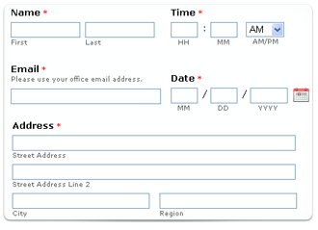
Quick overview

Slide 5
Quick overview
Forms are used to work with user input
Request method can be POST or GET
Input is stored in $_POST or $_GET arrays

Slide 6
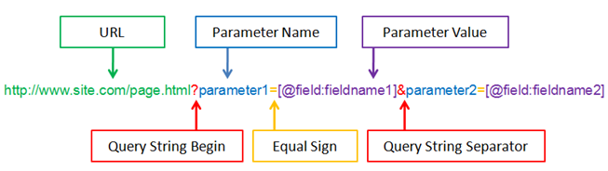
Query String

Slide 7
What is Query string?
A query string is a part of a URL. Specifically, the part of a URL following a question mark (?)
Commonly used in searches and dynamic pages
Stored in $_SERVER['QUERY_STRING']
http://www.site.com/index.php?parameter=softuni

Slide 8
Creating a Query string
Most common way to do it is by using a FORM with GET method
You can also use scripts to add to the query string or simply write your links with the query strings in the href attribute

Slide 9

Query string
Live Demo

Slide 10

Submitting arrays

Slide 11
Submitting arrays
In order for an input to be treated as an array – you must put brackets “[]” in the name attribute:
<form method=“post”>
<select name=“people[]" multiple="multiple">
<option value=“Mario">Mario</option>
<option value=“Svetlin">Svetlin</option>
<option value=“Teodor">Teodor</option>
</select>
<input type=“submit” value=“submit”/>
</form>

Slide 12
Submitting arrays (2)
After the form is sent you can access your elements like you are acessing an array
<?php
foreach( $_POST['people'] as $person ) {
echo $person . '</br>';
}
?>

Slide 13
Submitting Arrays
Live Demo

Slide 14


Combining HTML and PHP

Slide 15
Combining HTML and PHP
You can open PHP tags anywhere in HTML code
<?php
//guessing script implementation
...
$message = ...;
?>
<html>
...
<body>
<?php echo $message ?>
<form method=“POST”>
<input type=“text” name=“guess”>
<input type=“submit” name=“submit”>
</form>
</body>
</html>

Slide 16
Combining HTML and PHP
You can also echo the HTML
<?php
echo '
<form action=“index.php" method="post">
Name: <input type="text" name="name"><br />
<input type="submit“ name=“submit”>
</form>';
?>

Slide 17

Checkboxes

Slide 18
Checkoxes
Checkboxes are created by setting an input with type “checkbox”
A checkbox is only submitted if it's actually checked
<input type="checkbox" name=“rakia-checkbox" />

Slide 19
Checkboxes
Live Demo

Slide 20
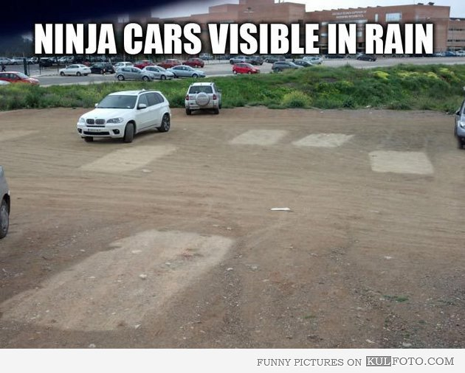
Hidden fields

Slide 21
Hidden fields
Created by setting the type of input to hidden
Not visible to the user
<form action=“input.php“ method="post">
<input type="text" name="user“>
<input type="submit" value=“click“ name=“in”>
<input type="hidden" name=“hiddenName"
value="<?php echo $user ?>"/>
</form>

Slide 22
Hidden fields
Live Demo

Slide 23
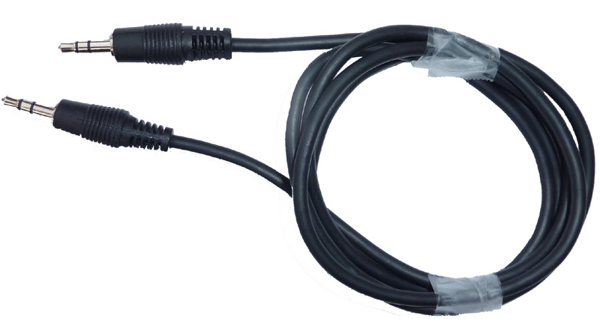
Other input types

Slide 24

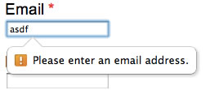
Other input types
password – doesn’t visualise the text written in the input
email – some mobile browsers change the on-screen keyboard (added @). Has some in-build email validations
radio - radio buttons are used to select ONLY one of a limited choices. In order for radio buttons to work properly – they must have the same “name” attribute

Slide 25
Other input types (2)
date – used to pick a date (Doesn’t work on Firefox and IE.)
datetime – used to pick date and time (Works only Safari and Opera)
time – used to pick time (Doesn’t work on Firefox and IE.)

Slide 26
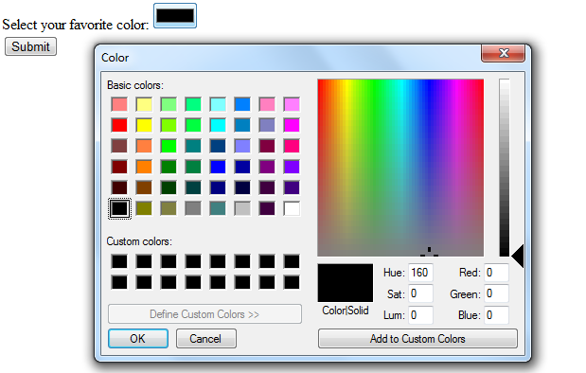
Other input types (3)
number – used to pick a number
range – creates a slider that allows you to pick a value from a previously set range
color – creates a palette that allows you to pick a color

Slide 27
Other input types
Live Demo

Slide 28

Specific input attributes

Slide 29
Specific input attributes
autocomplete – browser stores previously typed values and shows them the next time
autofocus – the field becomes focused on page load
required – the field becomes required and the form can not be send without filling/selecting it first

Slide 30
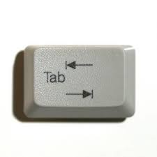
Tab index

Slide 31
Tab Index
The tabindex attribute controls the order in which form fields and links are focused when repeatedly pressing the TAB key
tabindex="0" (zero) – means "natural" order
Elements with smaller tabindex are iterated before elements with bigger tabindex

Slide 32
Tab index
Live Demo

Slide 33

Redirecting the user

Slide 34
Redirecting the user
Done by using the HTTP Location header
header(‘Location: http://softuni.bg’);
You can also use a variable to keep the URL
$url = ‘http://softuni.bg’);
header(‘Location: ‘ . $url);

Slide 35
Redirecting the user
Live Demo

Slide 36


Summary
You must put [] in input’s name attribute in
order to submit an array of information
You can easily combine PHP and HTML
Checkboxes are sent only if checked
Hidden fields are not visible to the user
The HTTP Location Header redirects the user
PHP & MySQL

Slide 37
PHP & MySQL
https://softuni.bg/trainings/fasttracks/details/1033

Slide 38
License
This course (slides, examples, demos, videos, homework, etc.) is licensed under the "Creative Commons Attribution-NonCommercial-ShareAlike 4.0 International" license
Attribution: this work may contain portions from
"PHP Manual" by The PHP Group under CC-BY license
"PHP and MySQL Web Development" course by Telerik Academy under CC-BY-NC-SA license

Slide 39





Free Trainings @ Software University
Software University Foundation – softuni.org
Software University – High-Quality Education, Profession and Job for Software Developers
softuni.bg
Software University @ Facebook
facebook.com/SoftwareUniversity
Software University @ YouTube
youtube.com/SoftwareUniversity
Software University Forums – forum.softuni.bg

